Slide 1

Counterspeech Prediction
Rahul Ramesh Omalur - 2022392
Noel Abraham Tiju - 2022338
Mehul Agarwal - 2022294
NLP - 2025

Slide 2
Why we chose this project?
In the day and age of extensive social media, we observed that along with the boons come pitfalls.For every useful piece of information propagated comes an unsolicited hate speech.
Using the knowledge gained in our NLP - 2025 course, we wish to come up with a solution to tackling said problem along with the work from past researchers of the issue.

Slide 3
Dataset

Slide 4
IntentConanv2
Used for training intent-aware counterspeech generation models, comprising 13,973 total samples (9,532 train / 2,971 val / 1,470 test) aligned with 3,583 unique hate speech instances.
The dataset includes 4 communicative intents — Informative, Denouncing, Questioning, and Positive with a balanced distribution across all splits.(Humor Intent not present in v2)
Each counterspeech is explicitly tagged with intent, reflecting the rhetorical strategy used to counter the corresponding hate speech.
The dataset is balanced across all four intents, with an equal number of samples per category in each split.
The dataset was curated by Gupta et al. in the paper “Counterspeeches up my sleeve! Intent Distribution Learning and Persistent Fusion for Intent-Conditioned Counterspeech Generation” (ACL 2023).

Slide 5
Some samples from the dataset
Hate speech:”Foreigners on UK benefits leaps 41 in 5 years with over 400K now handed payouts. This nonsense has got to stop.”
Intent | Counterspeech
Informative | You seem to be worried about government expenditure… it has actually been shown that, over time, migration reduces pressure on government spending.
Questioning | Do you even have the background information on this to be making such a strong statement?
Denouncing | Do you know how much money foreigners are giving the UK in taxes? Maybe it would be better to focus on stopping tax evasion.
Positive | I understand you’re frustrated - austerity has hit many hard.But most immigrants don’t claim benefits.Maybe we should focus our anger on poor pay and unfair systems.

Slide 6
Related Work

Slide 7
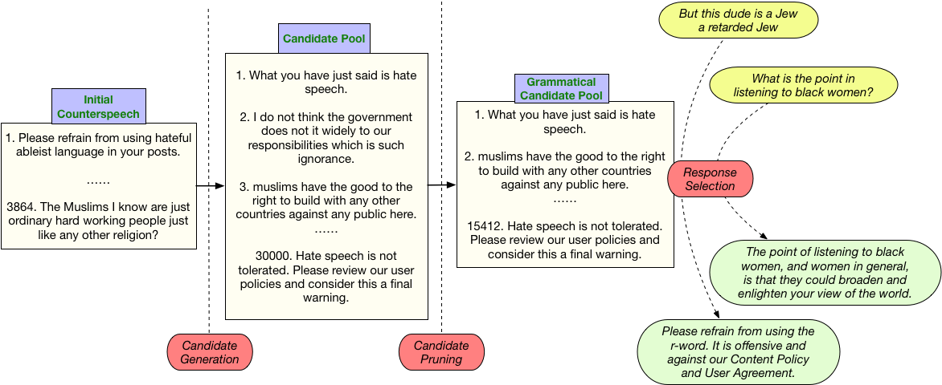
Generate,Prune,Select
Zhu, Wanzheng, and Suma Bhat. "Generate, prune, select: A pipeline for counterspeech generation against online hate speech." arXiv preprint arXiv:2106.01625 (2021).

Slide 8
An Overview
APA
Three-Stage Pipeline: GPS decomposes counterspeech generation into Generation, Pruning, and Selection — enabling control and interpretability at each step.
Diverse Candidate Generation: Uses a pre-trained VAE to generate a wide pool of candidate responses conditioned on hate speech.
Quality-Based Pruning: Introduces a Language Quality (LQ) classifier trained on CoLA standards to filter out ungrammatical or low-quality responses, ensuring fluency and coherence in counterspeech responses.
Contextual Response Selection: Employs retrieval models (e.g., TF-IDF) to select the most relevant response, with modularity to plug in more advanced selectors.

Slide 9
DialoGPT
Zhang, Yizhe, et al. "Dialogpt: Large-scale generative pre-training for conversational response generation." arXiv preprint arXiv:1911.00536 (2019).

Slide 10
An Overview
Model Overview: DialoGPT is a large-scale generative model fine-tuned on Reddit conversations.
Architecture: It is based on the GPT-2 autoregressive transformer architecture.
Use Case Relevance: Designed for human-like, multi-turn dialogue generation, making it applicable to counterspeech tasks.
Strength: Effectively captures long-range conversational dependencies.
Limitation: Often struggles with bland or inconsistent responses in sensitive domains like counterspeech.

Slide 11
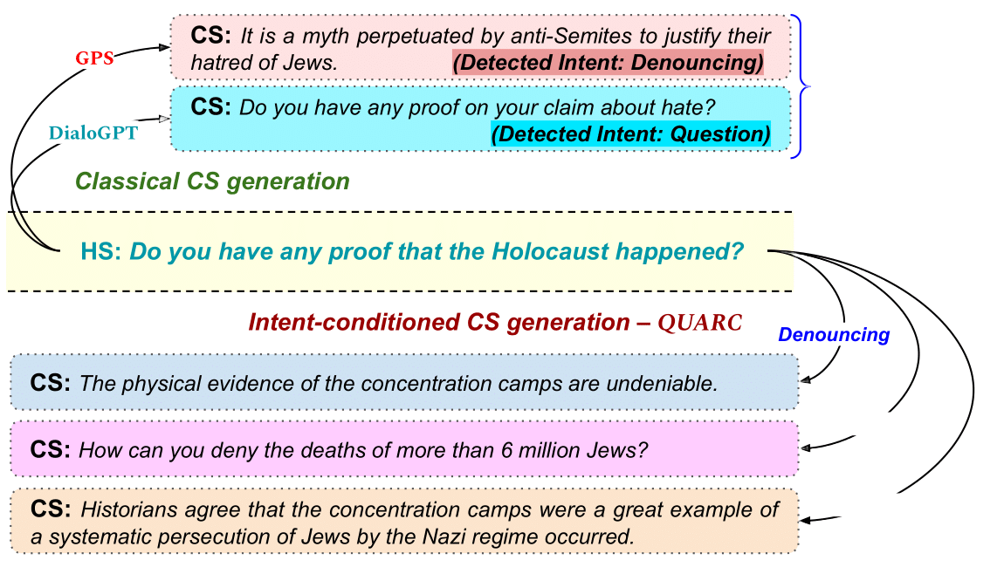
QUARC
Gupta, Rishabh, Shaily Desai, Manvi Goel, Anil Bandhakavi, Tanmoy Chakraborty, and Md Shad Akhtar. "Counterspeeches up my sleeve! intent distribution learning and persistent fusion for intent-conditioned counterspeech generation." arXiv preprint arXiv:2305.13776 (2023).

Slide 12
An Overview
Model Architecture: Proposes QUARC, a novel two-stage framework combining intent distribution learning and persistent fusion for intent-aware generation.
Fusion Module (PerFuMe): Introduces PerFuMe, a persistent fusion mechanism that integrates intent-specific representations into the decoding process.
Performance Gains: QUARC achieves up to 10% improvement over baselines on relevance, fluency, and intent alignment.
Human Evaluation: Human judgments confirm QUARC's effectiveness in generating intent-consistent and high-quality counterspeech.

Slide 13
Our Model Architecture: QUADRA

Slide 14
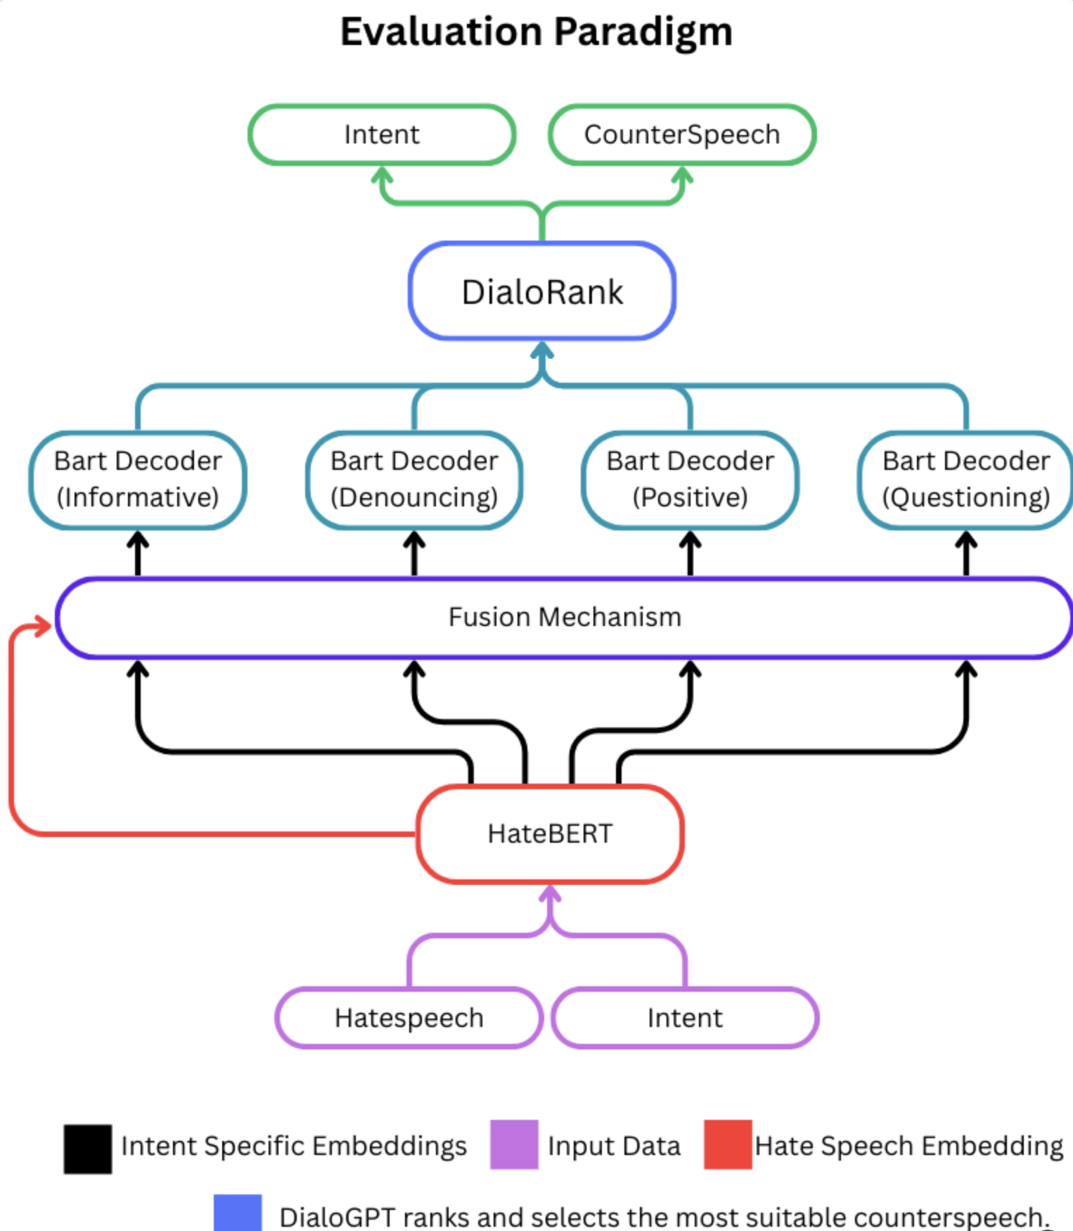
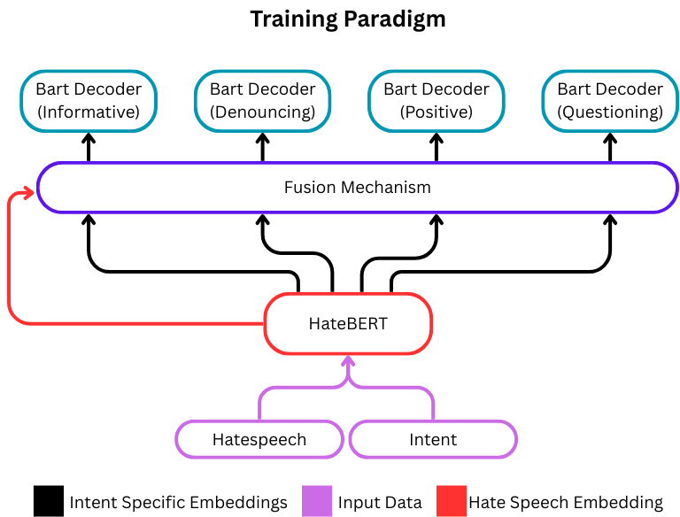

Slide 15
QUADBart + HATEBert
Domain-Specific Encoder : Utilizes HateBERT, a RoBERTa variant pre-trained on banned Reddit communities, to better capture implicit and veiled hate speech.It has been recorded to outperform BERT and RoBERTa on said task.
Intent-Specific Projections : A shared [CLS] embedding is passed through four intent-specific heads: Informative, Questioning, Denouncing, and Positive.
Lightweight Heads : Each head is a small feed-forward network projecting into an intent-aware latent space.
Parallel Decoding : These intent-specific embeddings are fed into four separate BART decoders,called QUADBERT each trained to generate responses aligned with a specific intent.

Slide 16
Fusion Mechanisms and DialoRank
Flexible Fusion Strategies : Three fusion types to combine hate speech and intent embeddings:
Linear (concatenation + projection)
Shared Fusion (cross-attention + gating)
Cross Attention (task-specific multi-head attention)
Intent-Aware Decoding : Each decoder generates a candidate response, explicitly tuned to its associated intent.
DialoRank – LLM-based Scoring : Uses DialoGPT-small to judge the appropriateness (1–10) of each generated candidate.
Best-Response Selection : The response with the highest DialoRank score is selected as the final output.
Intent Accuracy Metric : Evaluation includes checking if DialoGPT’s selected intent matches any gold label, enabling intent-level accuracy analysis.

Slide 17
Results

Slide 18
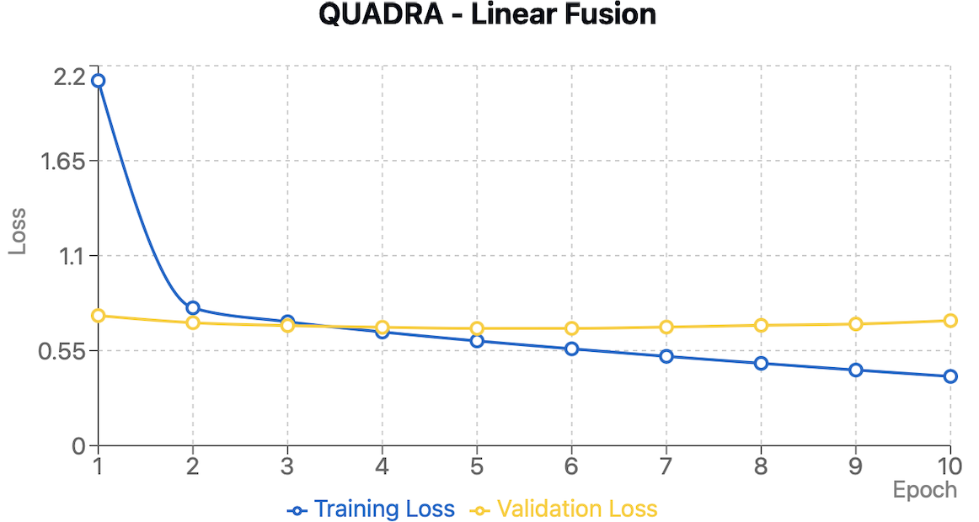
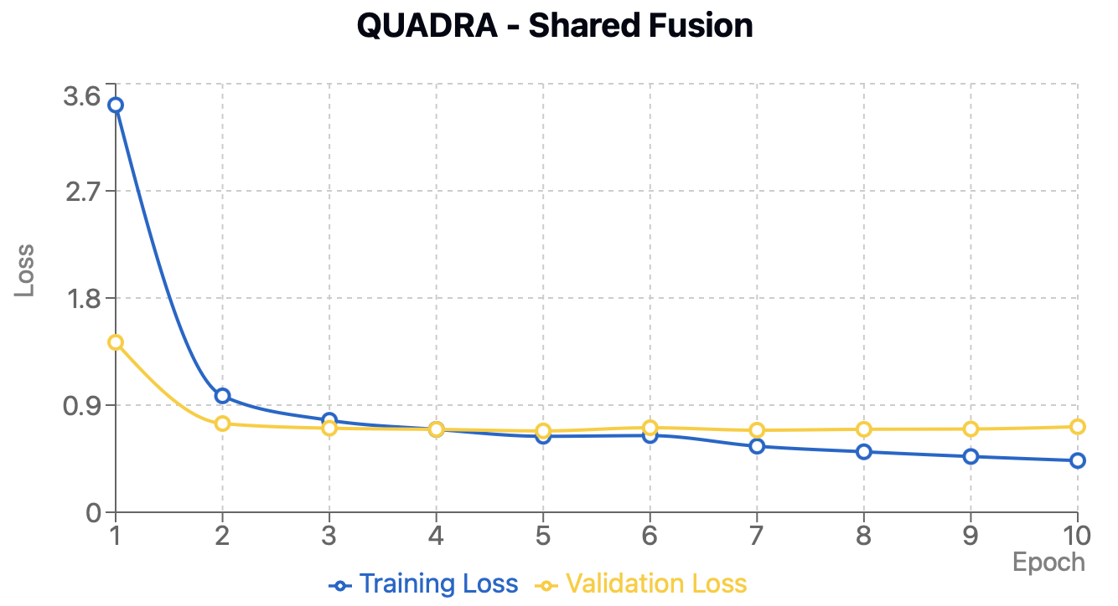
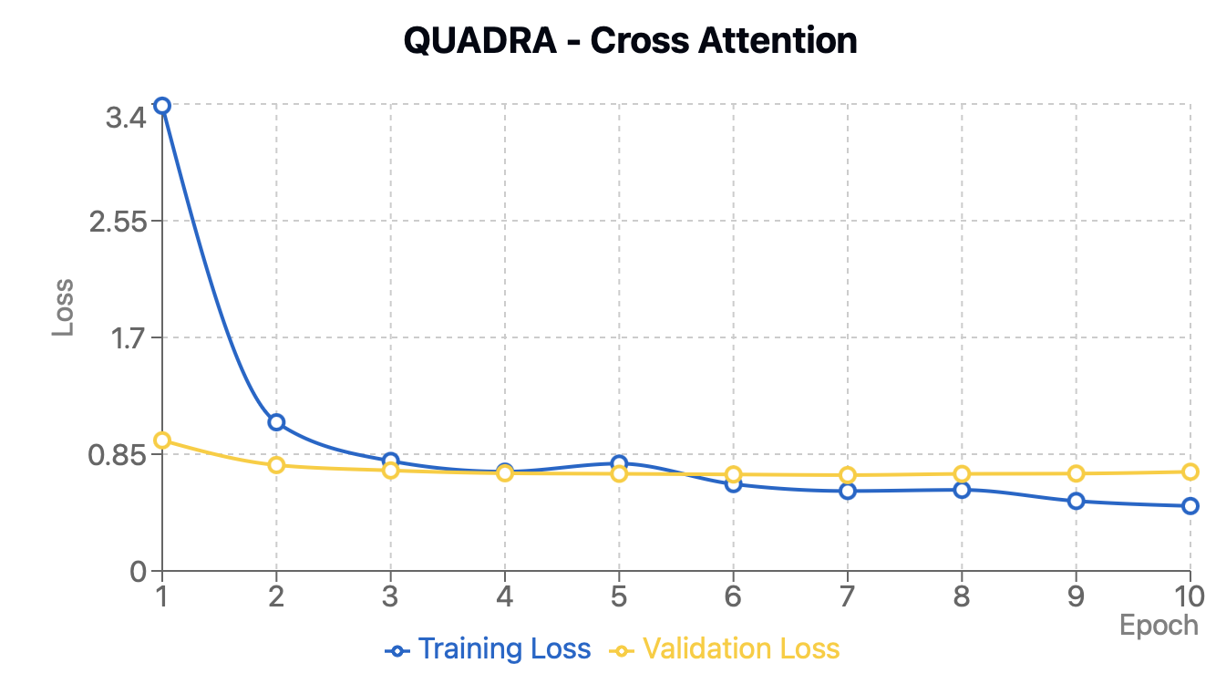
Loss plots for QUADRA models

Slide 19
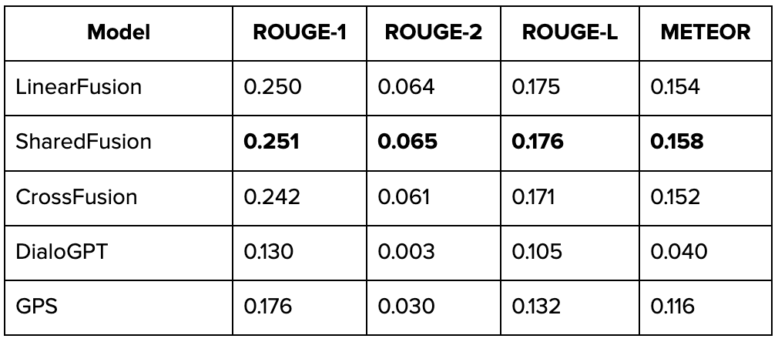
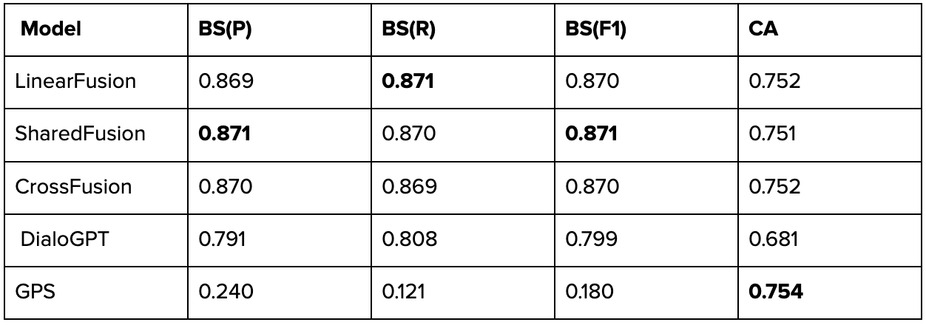
Text Generation Metrics
Semantic Similarity Metrics &
Category Accuracy Scores

Slide 20
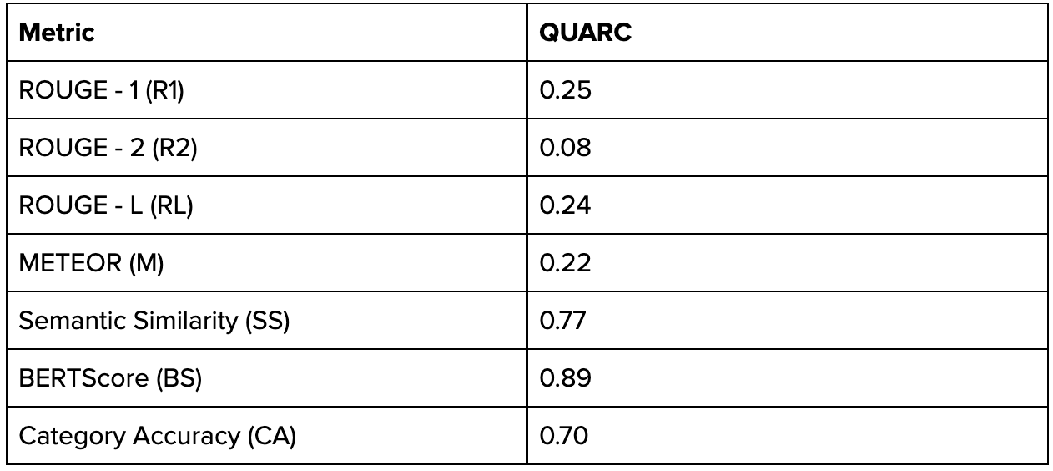
Additional QUARC metrics

Slide 21
Conclusion
By leveraging multiple intent-specific BART models in parallel and integrating a JudgeLM mechanism - DialoRank for selection, we demonstrate that counterspeech generation can be significantly improved through intent-aware decoding. This architecture not only enhances response relevance but also showcases a scalable framework for nuanced, context-sensitive intervention against hate speech.

Slide 22
Thank You!

